Slide 1


Flight Delay Prediction
An exploration of machine learning for predicting flight delays,.
Team Members: Dr Bhuvnesh Kumar, Kapil Khurana, Rishu Gera, Tarun Shekhawat, Ankush Chauhan
Cohort 3, M.Tech in AI&ML(Executive)

Slide 2
Introduction to Flight Delay Prediction (FDP)
Understanding the significance and impact of predicting flight delays
01
Flight delays
A significant issue in the aviation industry affecting both passengers and airlines
Delays can disrupt schedules, incur financial costs, and lead to customer dissatisfaction
Delays due to weather, ATC, Technical issues, late arrival, festive issues, security delays etc.
02
Importance of FDP
For improving efficiency, cutting costs, and enhancing passenger satisfaction
Optimizing airline operations by Utilizing delay predictions to streamline operations and reduce costs for airlines
03
Potential of predictive analytics in forecasting delays
FDP continuously monitor weather forecasts, air traffic conditions, and incoming flight statuses to update delay predictions as new data arrives
Proactive Decision-Making in resource allocation, passenger Communication, effective Crew and Aircraft Scheduling
Improved Collaboration with Air Traffic Control
Weather and Contingency Planning

Slide 3

Forecasting Flight Delays
Accurately predict flight delays by leveraging historical data and advanced machine learning techniques such as logistic regression, random forest, gradient boosting and Bayesian statistics
Identifying Patterns
Analyze vast datasets to uncover patterns and correlations that can boost predictive accuracy.
Reducing O/p Costs
Aim to lower operational expenses by anticipating delays and optimizing resource allocation.
Enhancing Passenger Experience
Improve the overall travel experience for passengers through timely notifications & adjustments.
Improving On-Time
Performance
Focus on increasing on-time performance metrics for airlines by minimizing delay occurrences.

Slide 4










Motivation for Using Machine Learning
Exploring the Benefits of machine Learning in Flight Delay Prediction
Scalability and Adaptability
Offers scalable and adaptable solutions for dynamic and
changing environments.
Machine Learning Tools
Utilizing logistic regression, random forest, gradient boosting and Bayesian statistics etc for analyzing complex datasets effectively.
Real-Time Predictions
Provides timely predictions to enhance decision-making and operational efficiency.
Predicting Flight Delays
Machine learning is ideal for accurately predicting flight delays in real-time.
Detecting Patterns
Efficiently detects intricate patterns that traditional
methods may miss.
Handling Large Data Volumes
Capable of processing and analyzing large volumes of data swiftly.

Slide 5
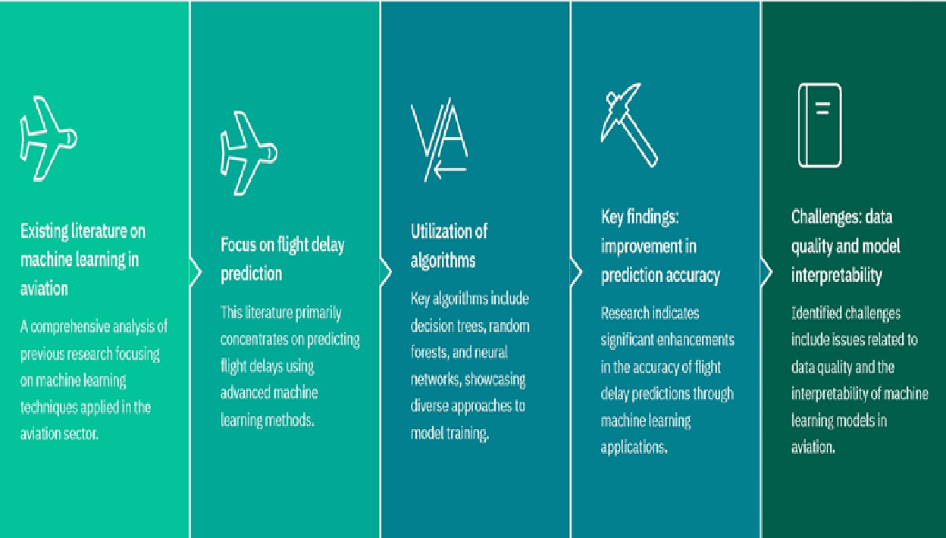
Literature Review on Machine Learning in Aviation
Exploring Machine Learning for Flight Delay Prediction via:
Think Bayes: Bayesian Statistics in Python
Various published papers

Slide 6
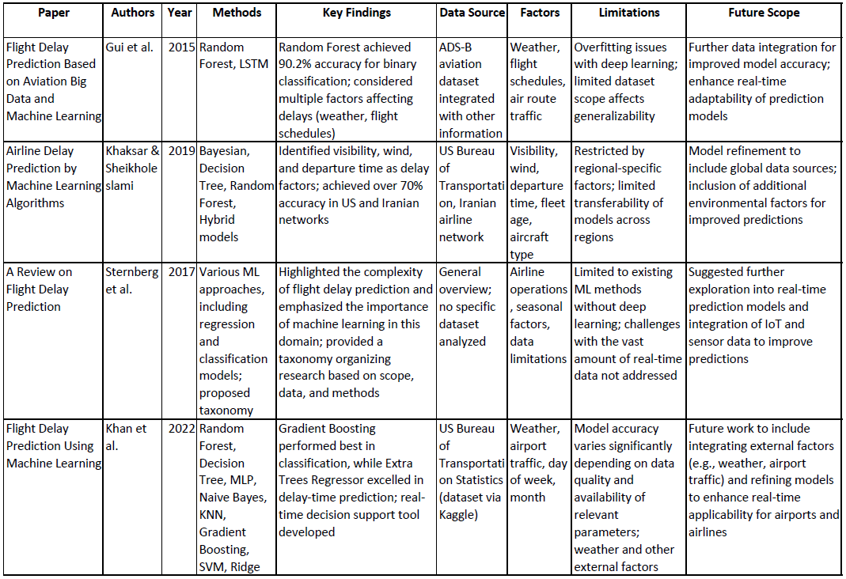

Slide 7
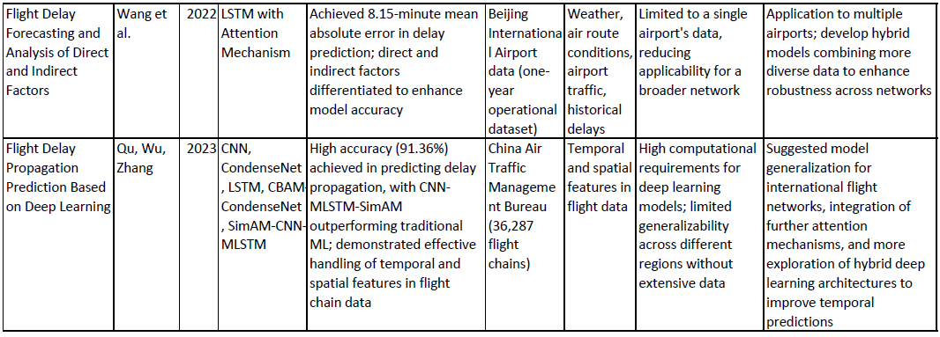

Slide 8
Data Collection for Flight Delay Prediction
Understanding the Importance of Data in Predictive Models
e e e e
Crucial Role of Data Collection
Data collection is crucial for accurate predictions, forming the foundation of reliable models.
Types of Data
Involves gathering historical flight data, weather conditions, air traffic information, and other relevant factors.
Source of Datasets
Datasets from sources like the Bureau of Transportation Statistics and weather agencies provide necessary information.
Ensuring Data Quality
Ensuring data quality and completeness is fundamental to developing robust prediction models.

Slide 9
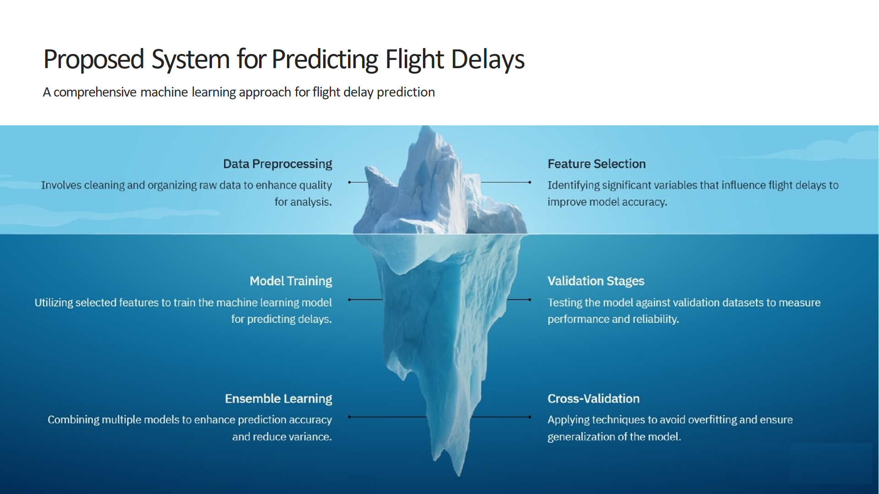

Slide 10
Experimental Methodology
A structured approach to evaluating the flight delay prediction system
Experimental methodology
A structured experimental methodology is essential for evaluating the proposed system effectively.
Controlled environment setup
Establishing a controlled environment is crucial for minimizing external variables that might affect results.
Evaluation metrics definition
Defining evaluation metrics like accuracy, precision, recall, and F1-score ensures robust model assessment.
Real-world applicability
The methodology ensures that the predictions made are reliable and applicable in real-world scenarios
Selection of machine learning models
Choosing appropriate machine learning models is vital for accurately predicting flight delays

Slide 11
Results and Discussion
Insights into the effectiveness and limitations of machine learning for flight delay prediction
Machine learning models (logistic regression, random forest, gradient boosting and Bayesian statistics) demonstrated a significant ability to predict flight delays accurately.
Effectiveness of machine learning models
Improved prediction accuracy
These models provided better prediction accuracy compared to traditional forecasting methods.
Challenges encountered
The study may face several challenges, including data quality and integration issues.
Limitations of the methodology
Certain methodological limitations affected the overall predictive performance of the models.

Slide 12

Machine learning models effectiveness
Each model offers unique strengths and combining these through ensemble methods or stacking can often yield the most accurate and reliable predictions for flight delays.
Logistic Regression
Logistic regression is a straightforward yet effective classifier for binary outcomes, such as predicting whether a flight will be delayed or not.
It can still offer valuable insights, especially when delays are influenced by linear relationships among variables.
It might lack the depth needed for highly complex interactions, which limits its predictive power in certain cases.
Random Forest
Random forests leverage ensemble learning, combining multiple decision trees to improve accuracy and control overfitting.
This model is particularly effective for flight delay prediction, as it handles high-dimensional data well and captures nonlinear relationships between features.
Random forests are often favoured in this domain due to their robustness and ability to provide feature importance, which helps to identify the most influential factors behind delays.

Slide 13
Machine learning models effectiveness
Machine learning models are proven to be effective tools for predicting flight delays, offering reliable forecasts.
Gradient Boosting
Gradient boosting models are highly accurate and handle large, complex data sets with ease, which is beneficial for flight delay prediction.
These models work by building trees sequentially, learning from errors made by previous trees. This adaptability leads to strong predictive performance, especially for rare events.
While often outperforming random forests in terms of accuracy, gradient boosting can require more tuning and may be more computationally intensive.
Bayesian Statistics
Bayesian models are useful for incorporating prior knowledge or expert judgment about delays, making them suitable when historical patterns or domain knowledge can improve predictions.
In flight delay prediction, Bayesian approaches can incorporate weather forecasts and traffic data probabilistically, providing not just a prediction but also a degree of uncertainty, which is crucial in operations planning.
These models can sometimes lack the power of more complex ML models for large-scale prediction but are excellent for making informed decisions under uncertainty.

Slide 14

Advantages and Disadvantages of the Application
Exploring the pros and cons of machine learning in flight delay prediction
Enhanced accuracy Machine learning models can significantly improve prediction accuracy compared to traditional
methods.
Need for continuous updates
Models require regular updates to maintain accuracy as flight patterns and factors change over time.
Complexity
The complexity of machine learning models can pose challenges in understanding and interpreting results.
Cost savings
By optimizing resources and minimizing delays, machine learning can lead to substantial cost reductions.
Improved customer satisfaction
Accurate predictions enhance the passenger experience by providing timely updates and reducing frustration.
Data quality
High-quality, reliable data is crucial for effective machine learning model performance and accuracy.

Slide 15

Unlock the Future of Air Travel Management

